Slide 1
The slides below demonstrate the use of QHP2008 model to simulate physiological responses to baroreflex activation, as described in the manuscript “Lowering of blood pressure during chronic suppression of central sympathetic outflow” by R. Iliescu and T.E. Lohmeier , submitted for publication in Clin. Exp. Phramacol. Physiol.
General:
  The model was allowed to run for 3 months for stabilization of all variables
  Baroreflex activation is simulated by increasing the value of afferent baroreceptor input into CNS
  Renal adrenergic activity can be clamped by fixing alpha and beta adrenergic receptor activity to 1.
  Plasma concentrations of ANP , Angiotensin II and Aldosterone can be clamped by fixing their value to control levels
  Renal interstitial fluid pressure is determined by renal perfusion pressure and renal venous pressure. The renal venous pressure has an effect on renal interstitial fluid pressure, only when it increases above control levels. The effect of renal venous pressure on renal interstitial fluid pressure can be removed .
  Detailed description of the simulation steps and the use of QHP2008 follows:

Slide 2
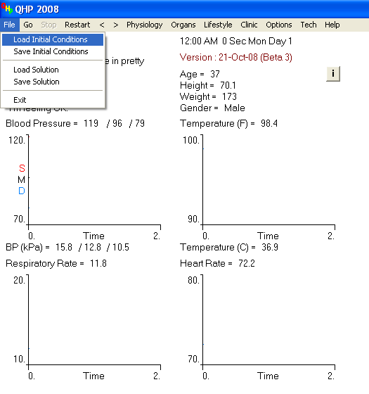
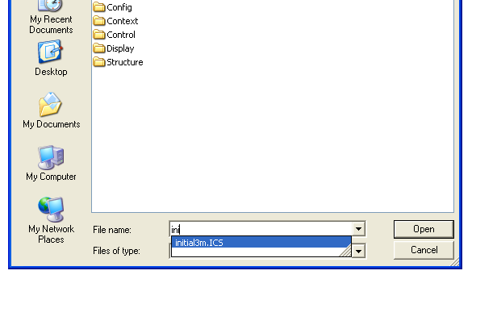
Load initial conditions
(3 months stabilization)
Make sure the file “initial3m.ICS” is in the same directory as the “QHP2008.exe”
In the “Open” window, type “initial3m.ICS” in the “File name” field
Click “Open”

Slide 3
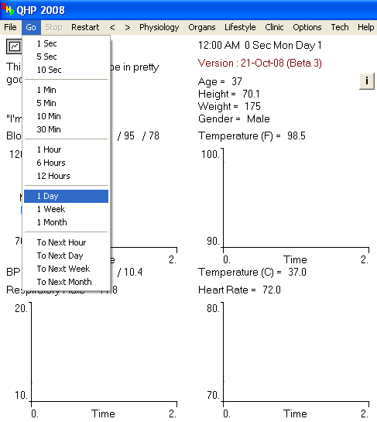
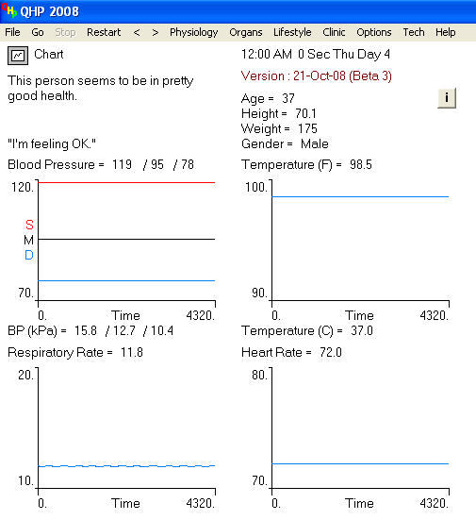
Run 3 days of baseline
( 3 X 1 day)

Slide 4
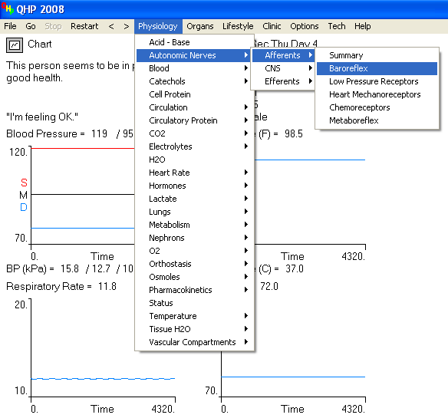
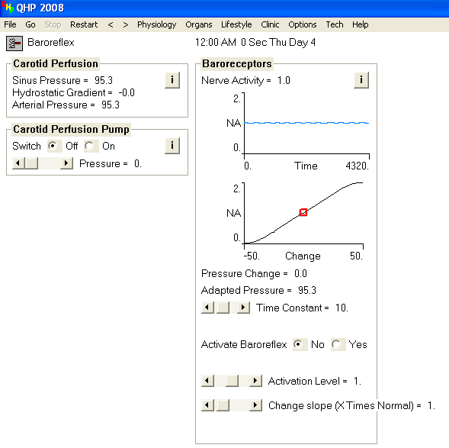
Increase baroreflex afferent input into CNS
“ Activate Baroreflex”
Click “Yes”
“Activation level”
Slider bar – to 1.7

Slide 5
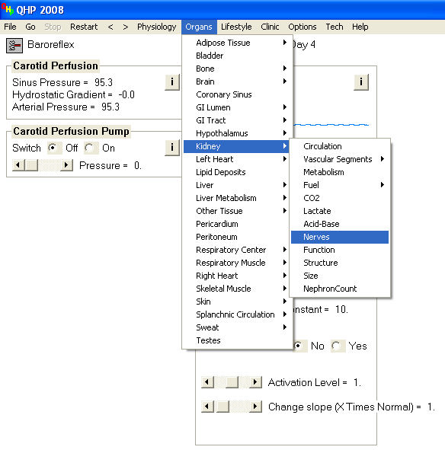
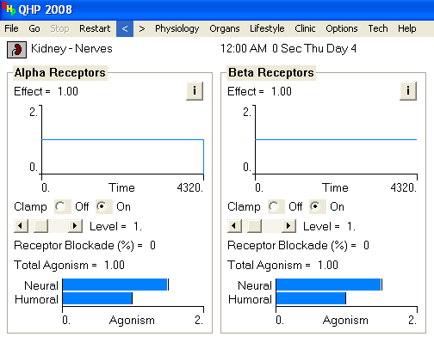
Fix activity of renal alpha and beta adrenergic receptors
“ Clamp”
Click “On”
“Level”
Slider bar – to 1

Slide 6
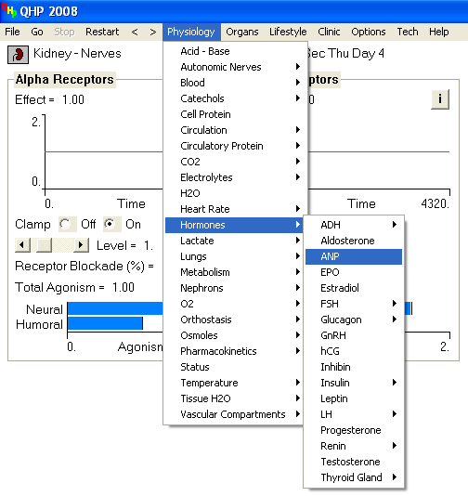
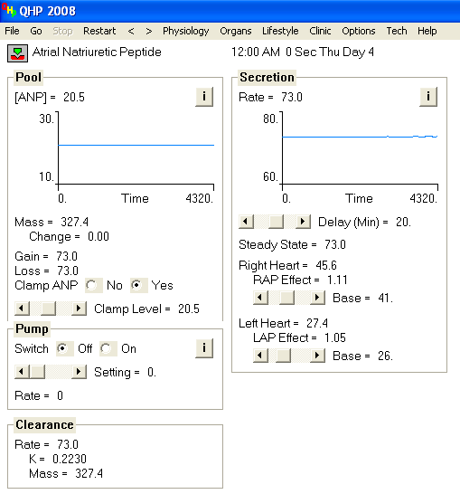
Fix plasma ANP concentration to control levels
“ Clamp ANP”
Click “Yes”
“Clamp Level”
Slider bar – to 20.5

Slide 7
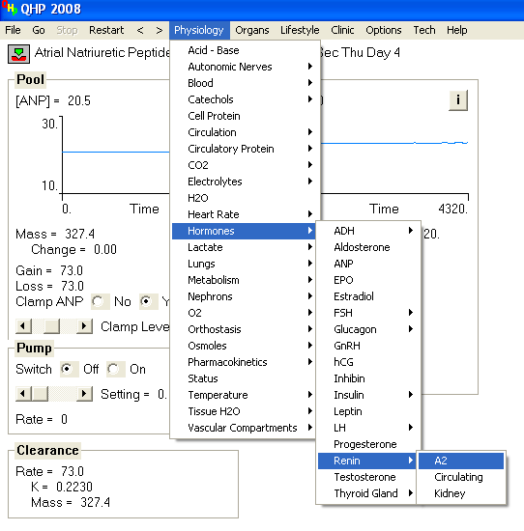
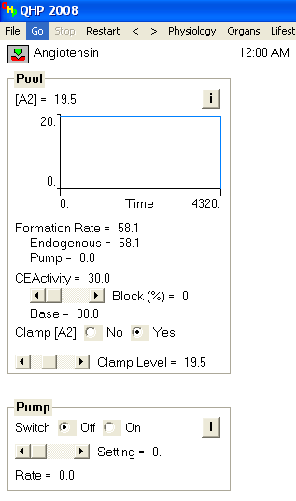
Fix plasma Angiotensin II concentration to control levels
“ Clamp [A2]”
Click “Yes”
“Clamp Level”
Slider bar – to 19.5

Slide 8
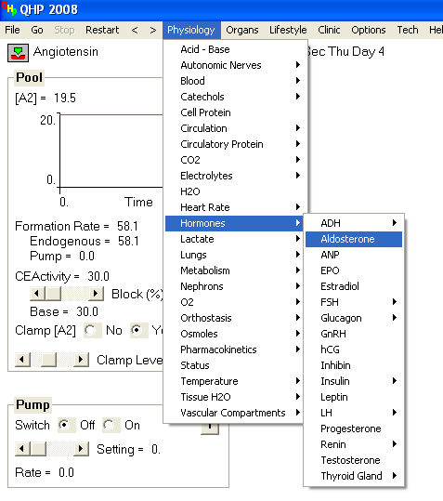
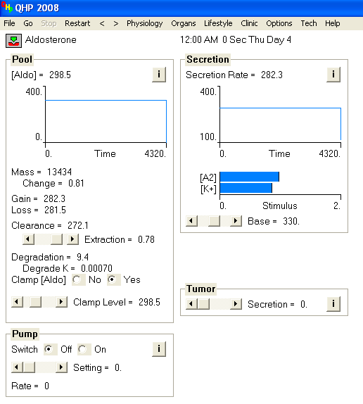
Fix plasma Aldosterone concentration to control levels
“ Clamp [Aldo]”
Click “Yes”
“Clamp Level”
Slider bar – to 298.5

Slide 9
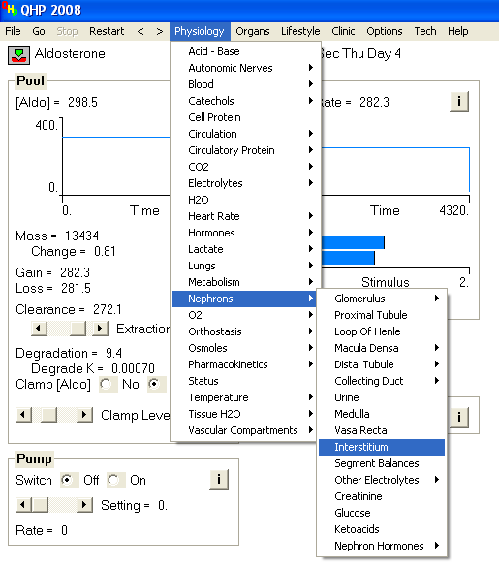
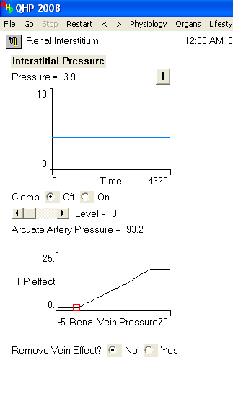
Remove influence of Renal Vein Pressure on Renal Interstitial fluid Pressure
“ Remove Vein Effect?”
Click “Yes”

